Slide 1
Shine bright like a diamond
Yuqing Wang

Slide 2
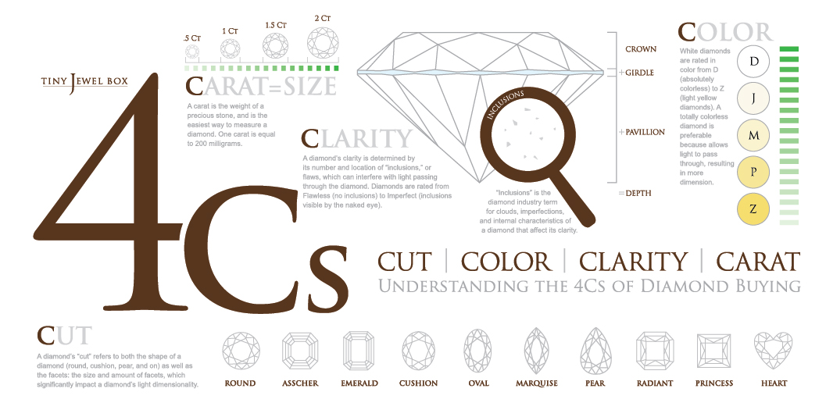

Slide 3

Importance: Carat>Cut>Color>Clarity
✖️6

Slide 4
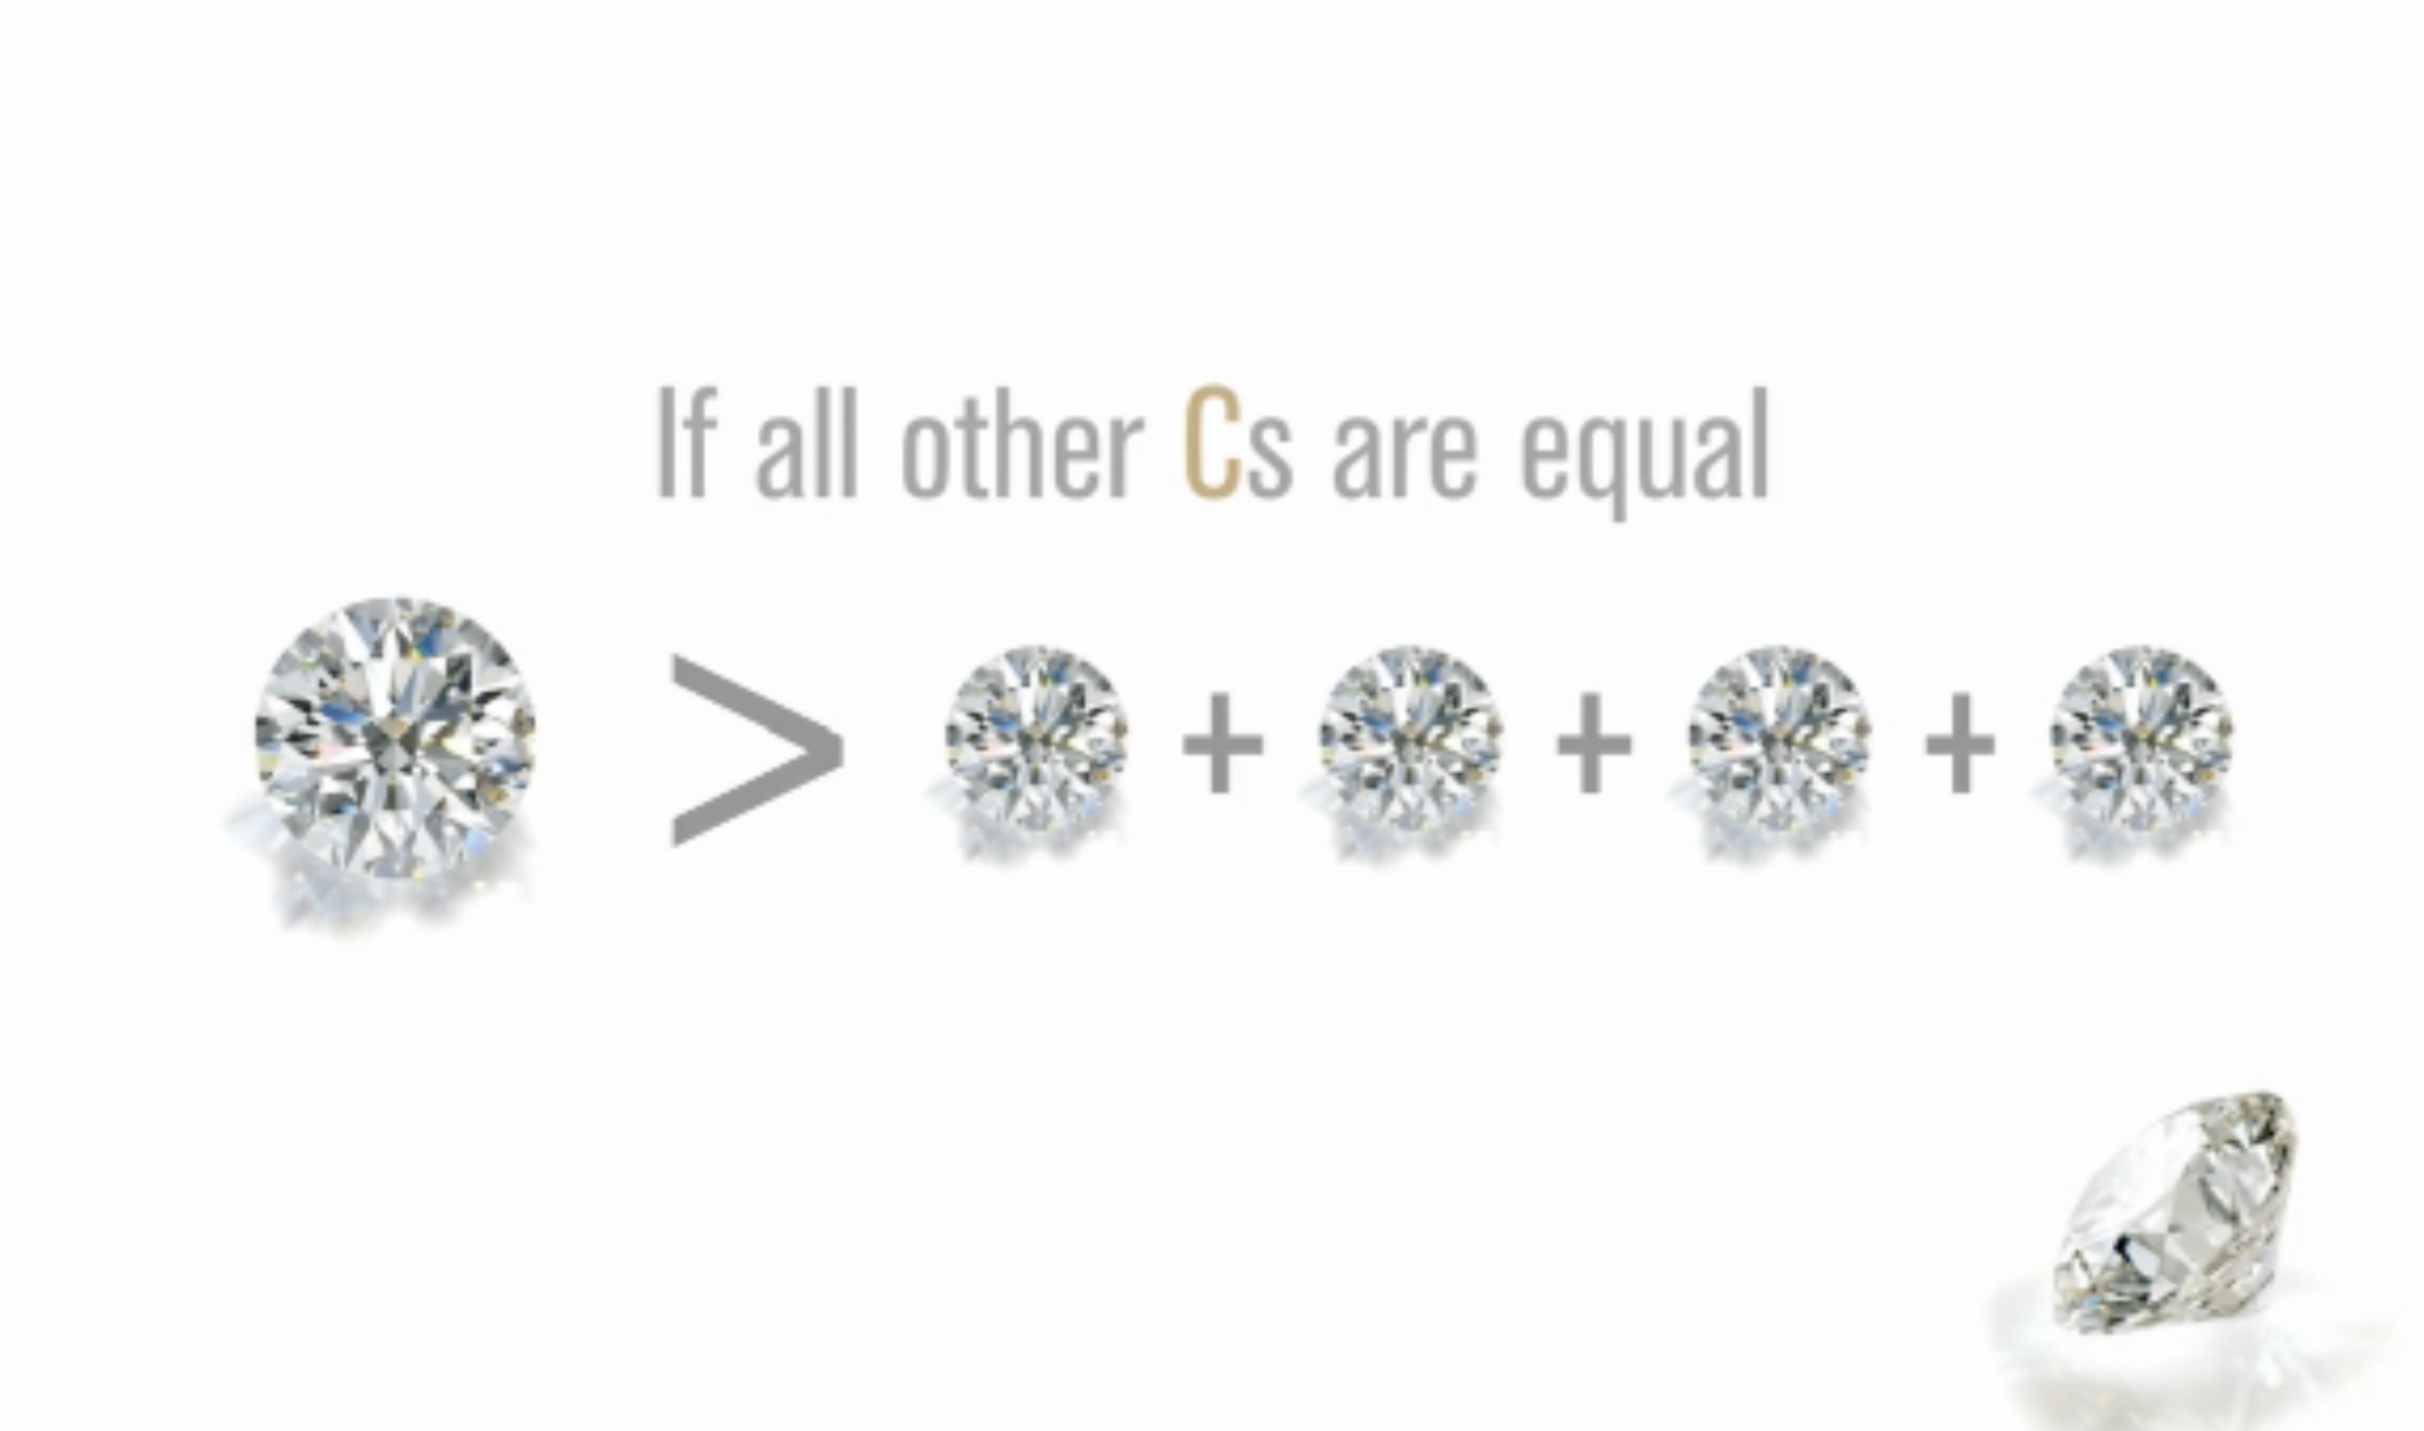

Slide 5
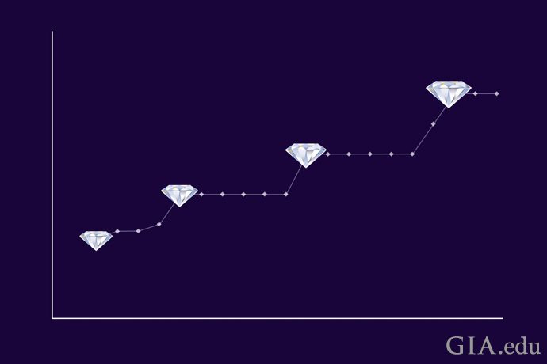
popular carat (magic size):
0.25, 0.5, 0.75, 1.0, 1.5….

Slide 6
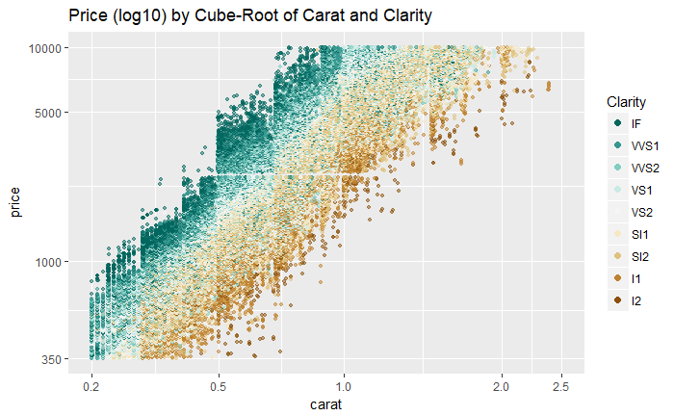
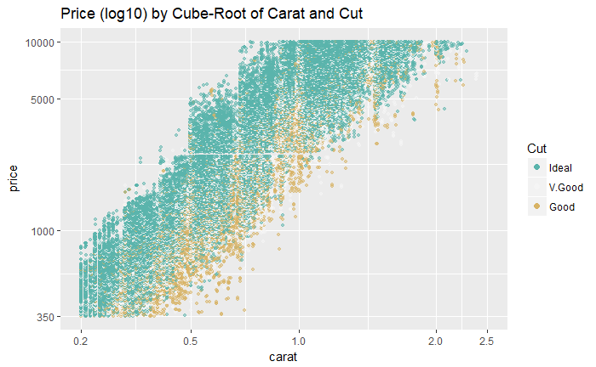
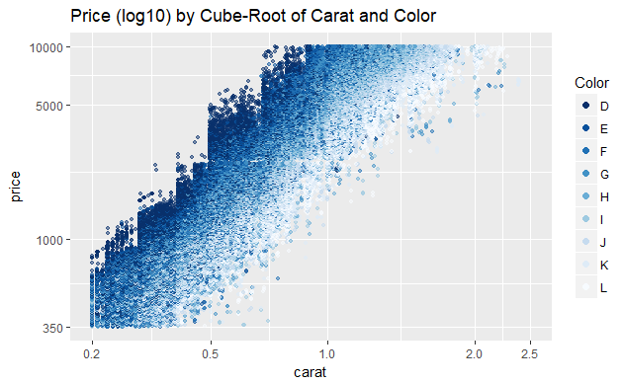

Slide 7
Importance: Carat>Cut>Color>Clarity

Slide 8
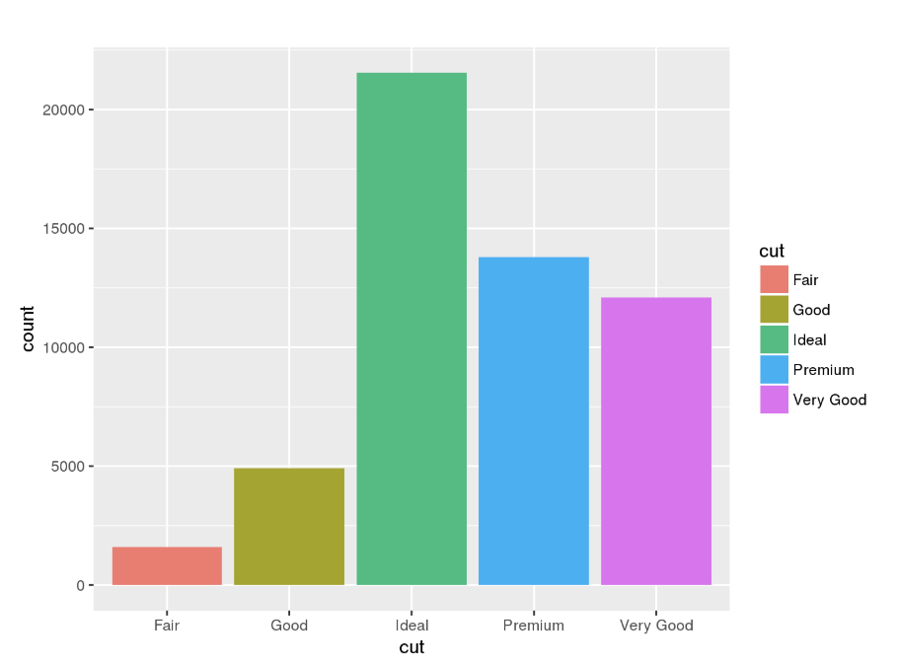

Slide 9
Importance: Carat>Cut>Color>Clarity

Slide 10
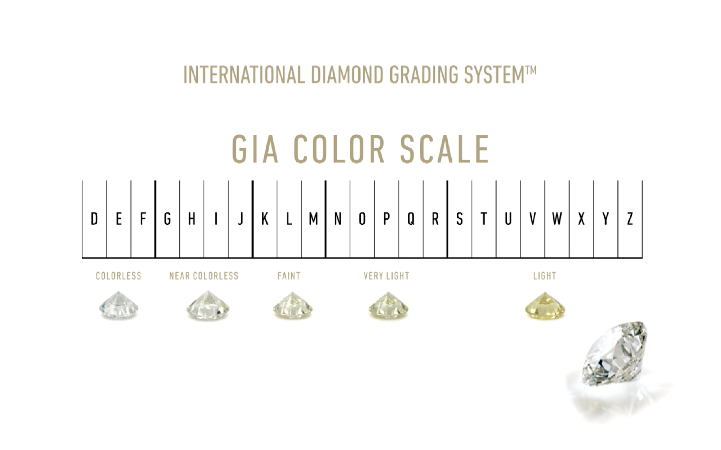

Slide 11
Importance: Carat>Cut>Color>Clarity

Slide 12
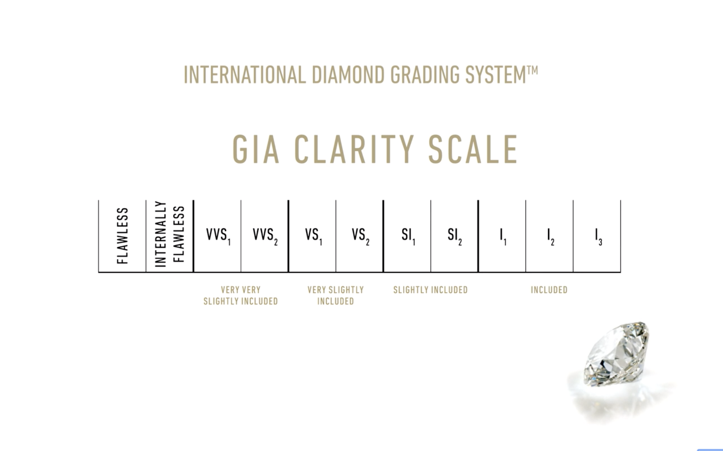

Slide 13
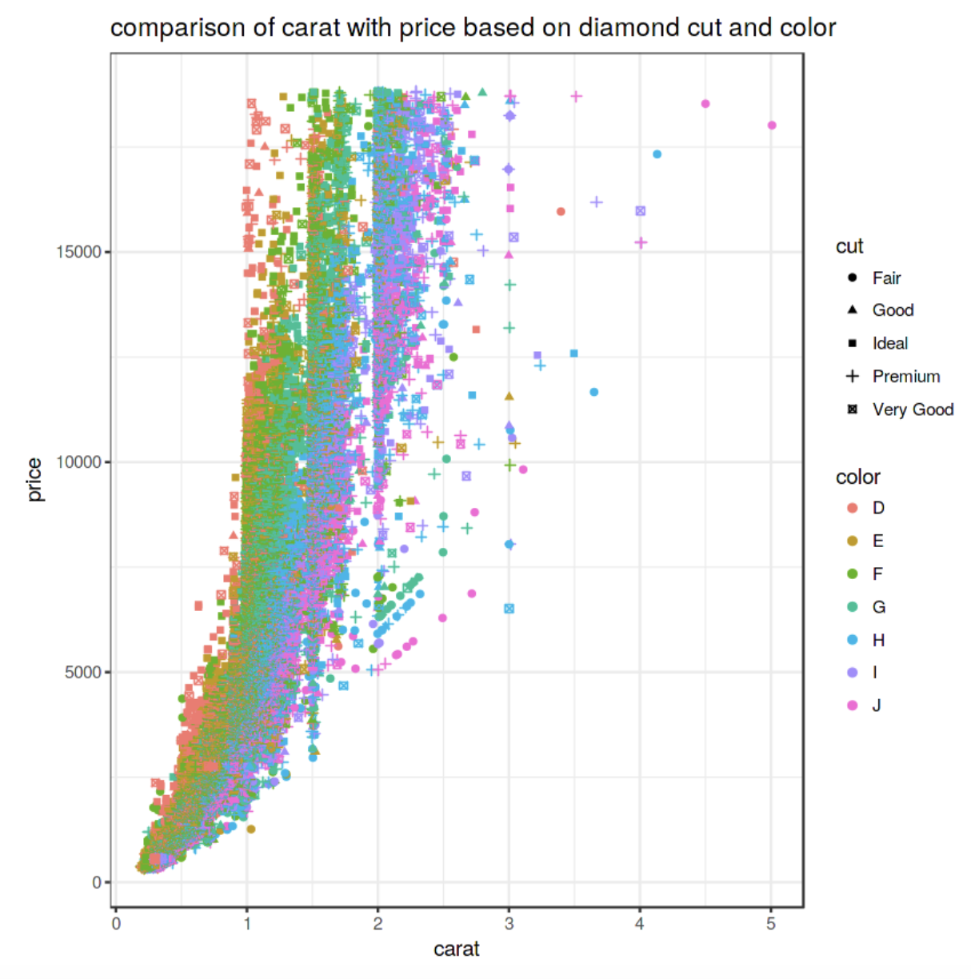

Slide 14
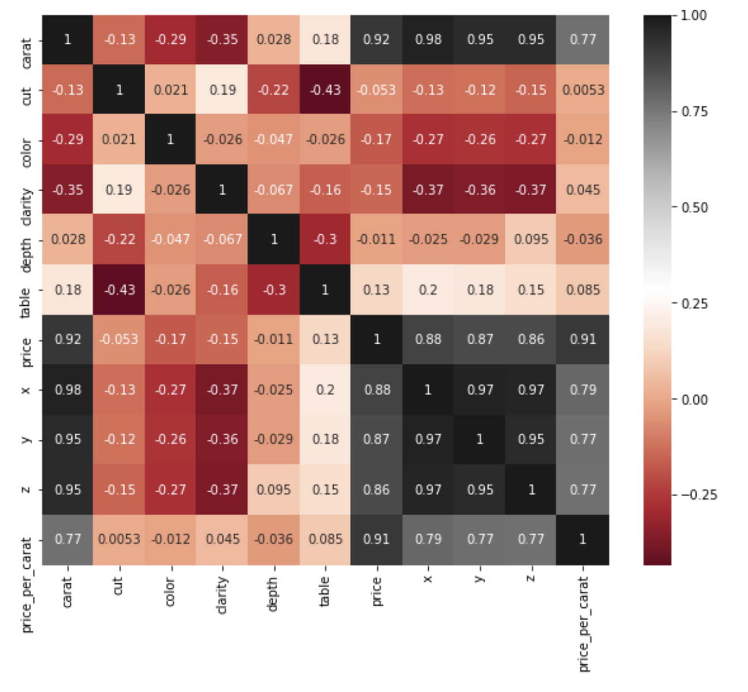

Slide 15
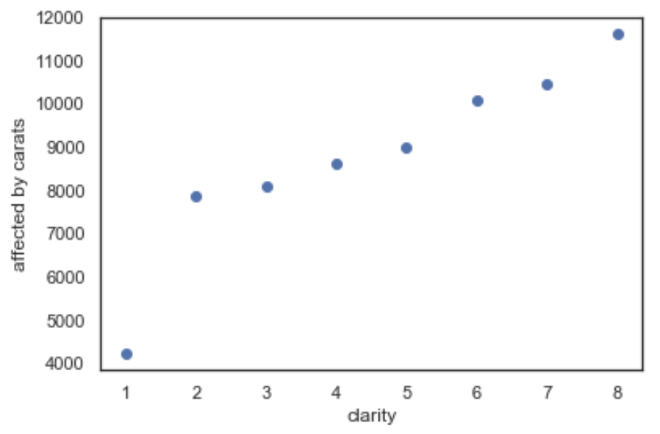
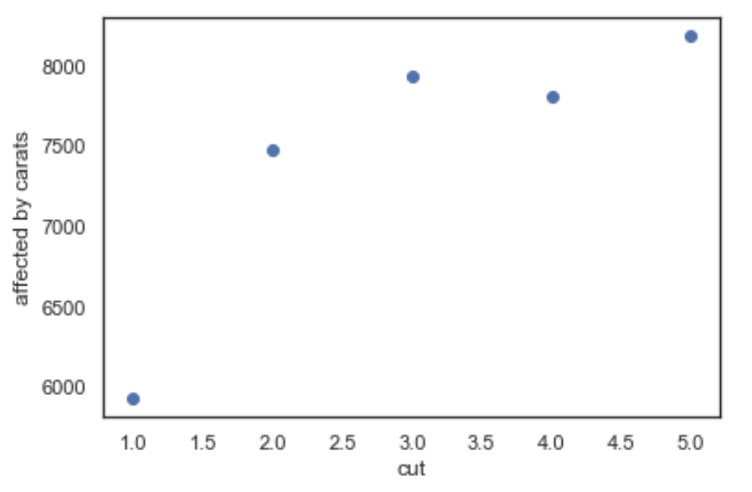

Slide 16
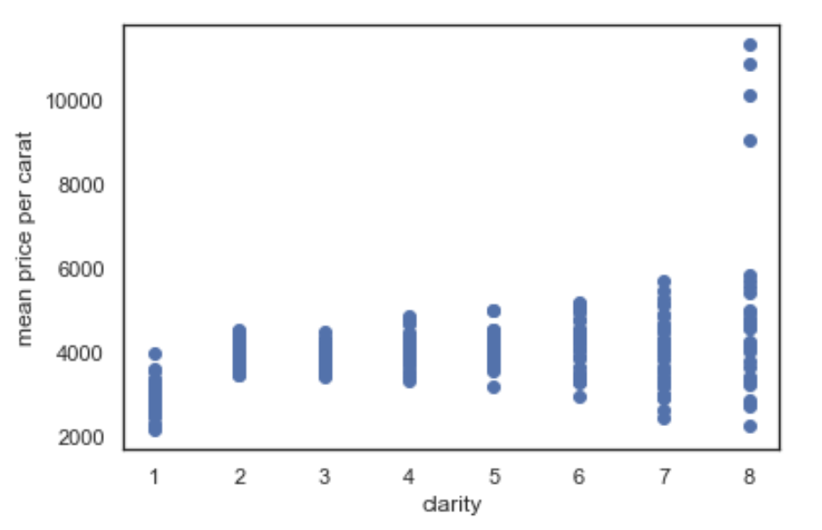
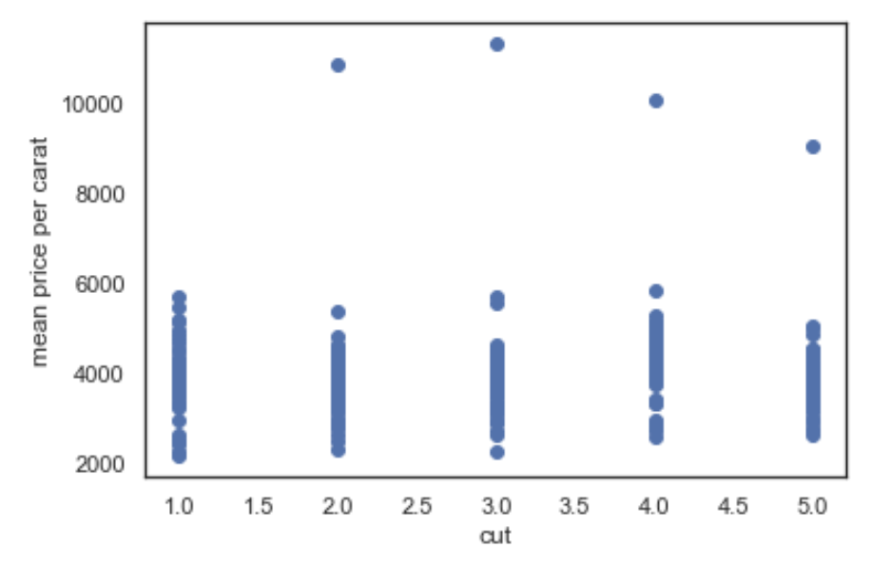
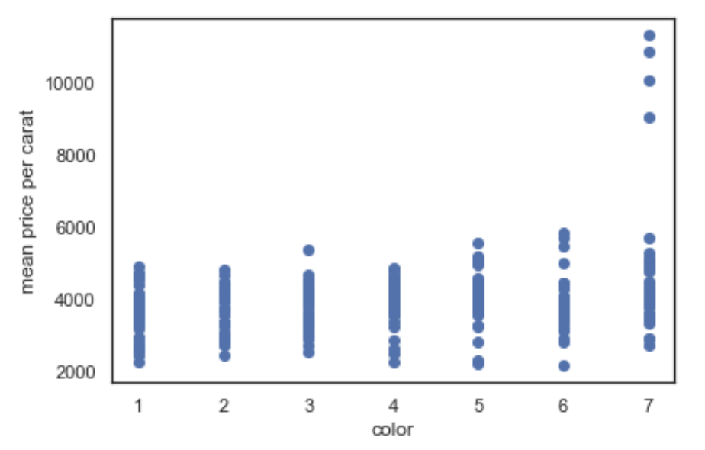

Slide 17
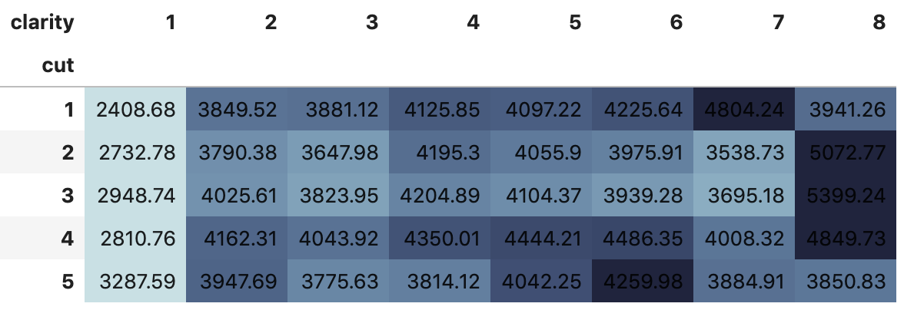
Mean Price per Carat

Slide 18
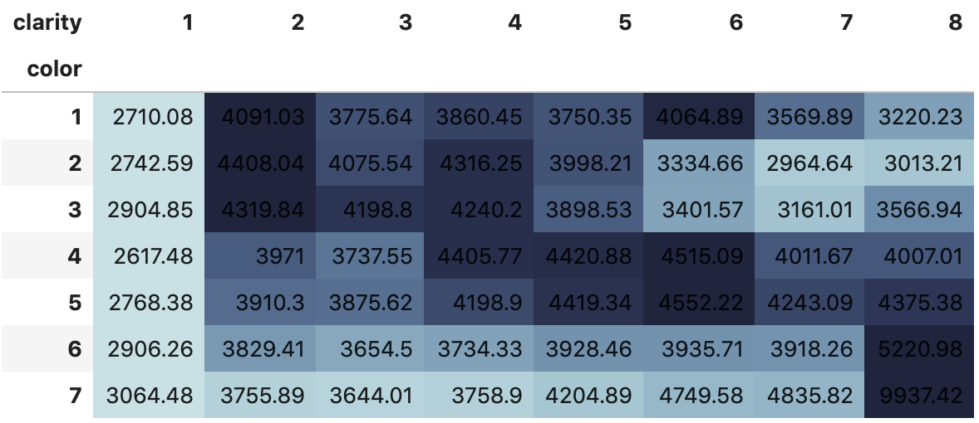
Mean Price
per Carat

Slide 19
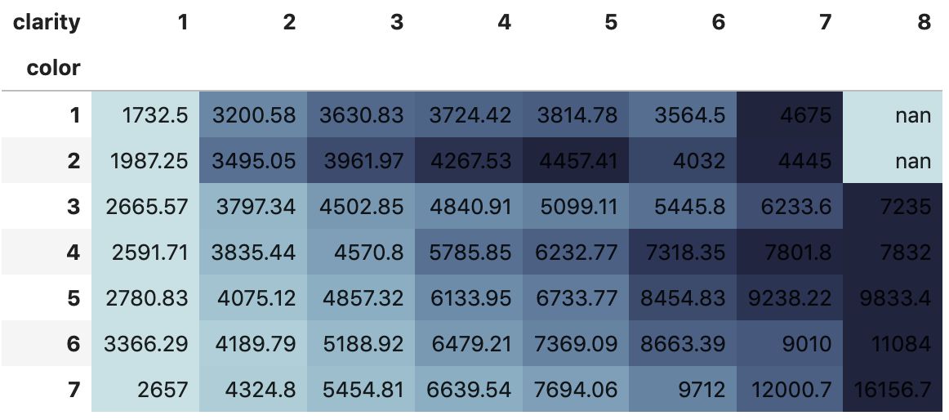
Mean Price
per Carat
1 carat.

Slide 20
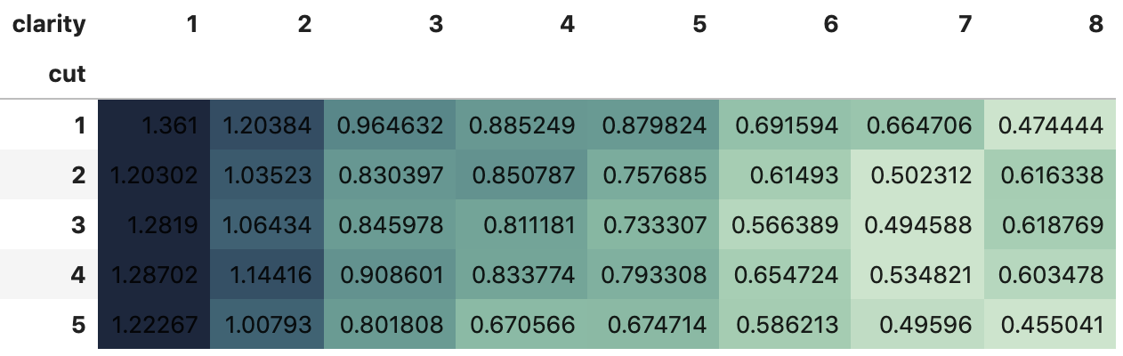
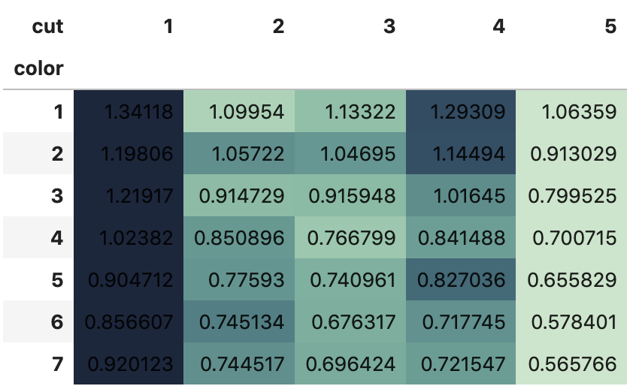
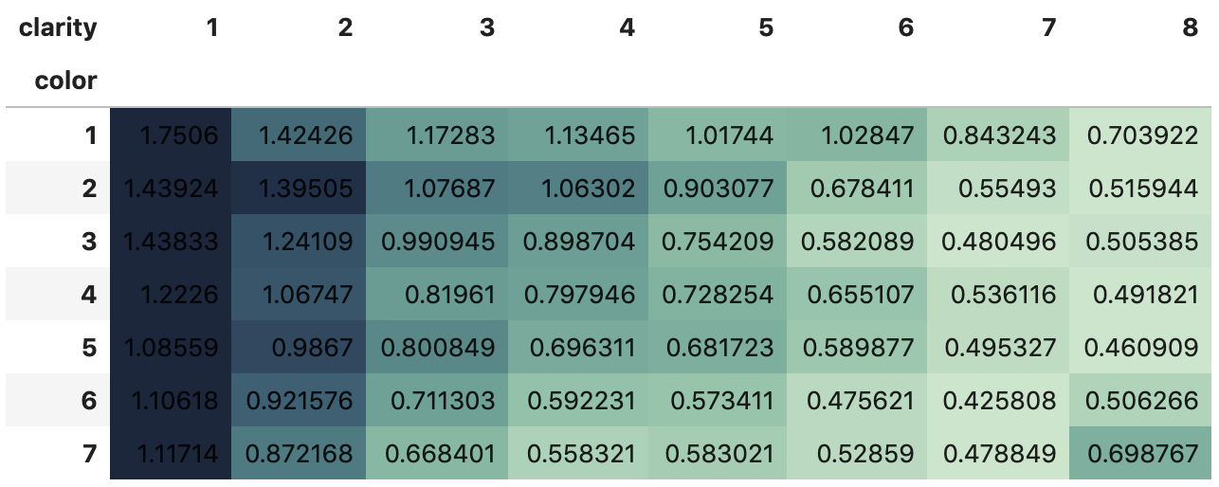
Mean Carats

Slide 21
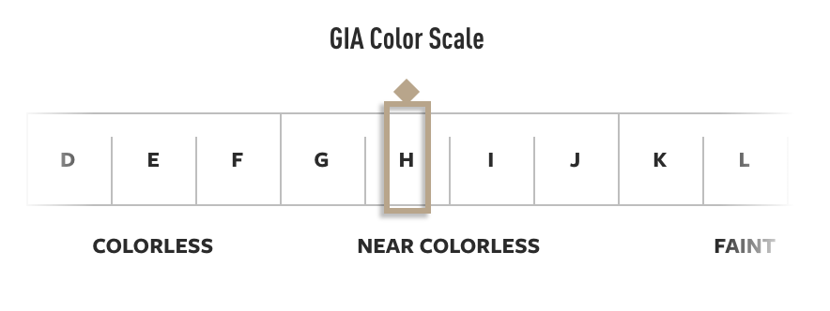
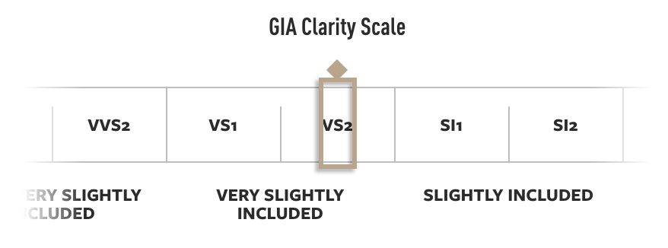
Tips for buying a diamond:
Color: H-G(3-4);
Cut: Excellent(5);
Clarity: VS2(very slightly included);
Carat: the bigger the better & magic size

Slide 22

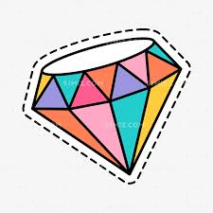
Supervised Learning:
Regression Analysis:
Dependent variable is continuous numerical variable.
Classification Analysis:
Dependent variable is categorical variable.

Slide 23
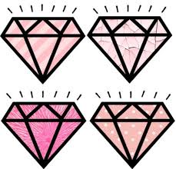
Linear Regression (0.97):
one dependent variable & one or more independent variables
Ridge Regression (0.97):
Penalizes models based on their complexity, favoring simple models
Random Forest (0.99):
composed of multi weaker models to make the overall prediction

